Slide 1
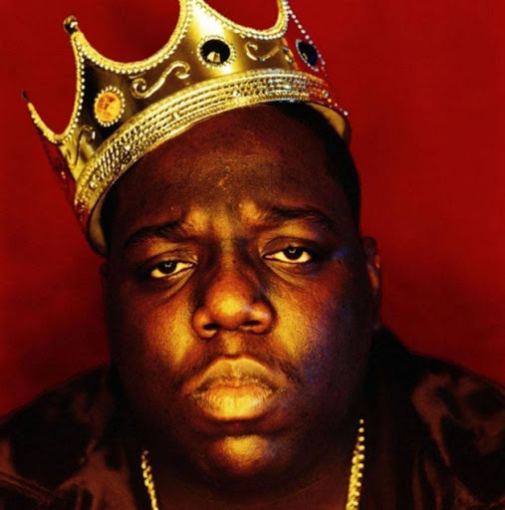
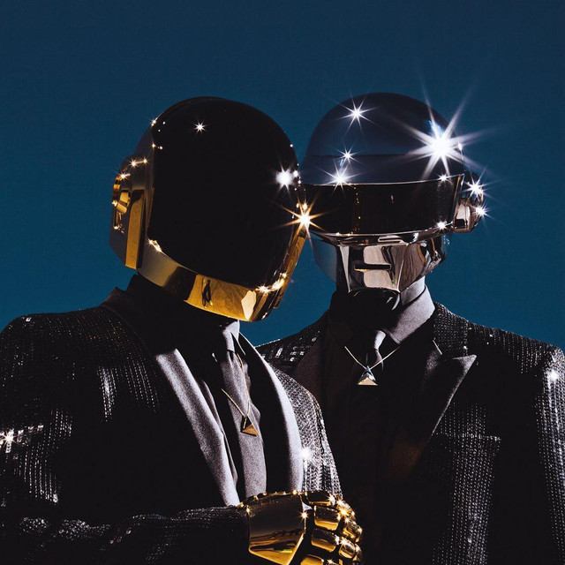
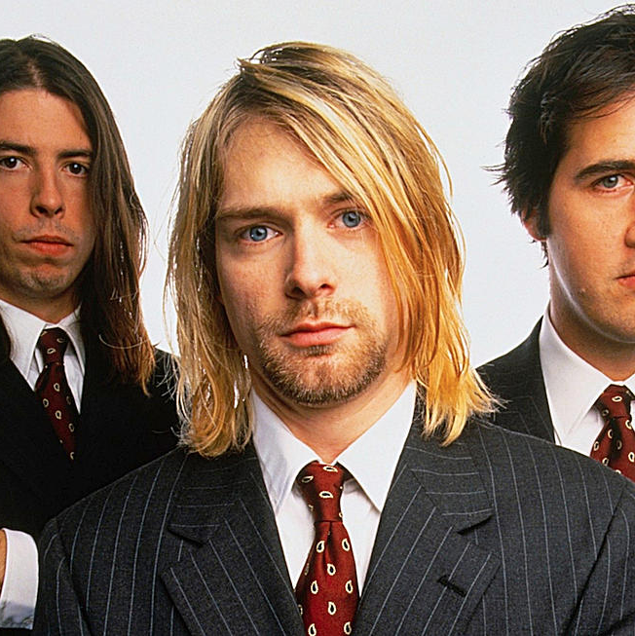
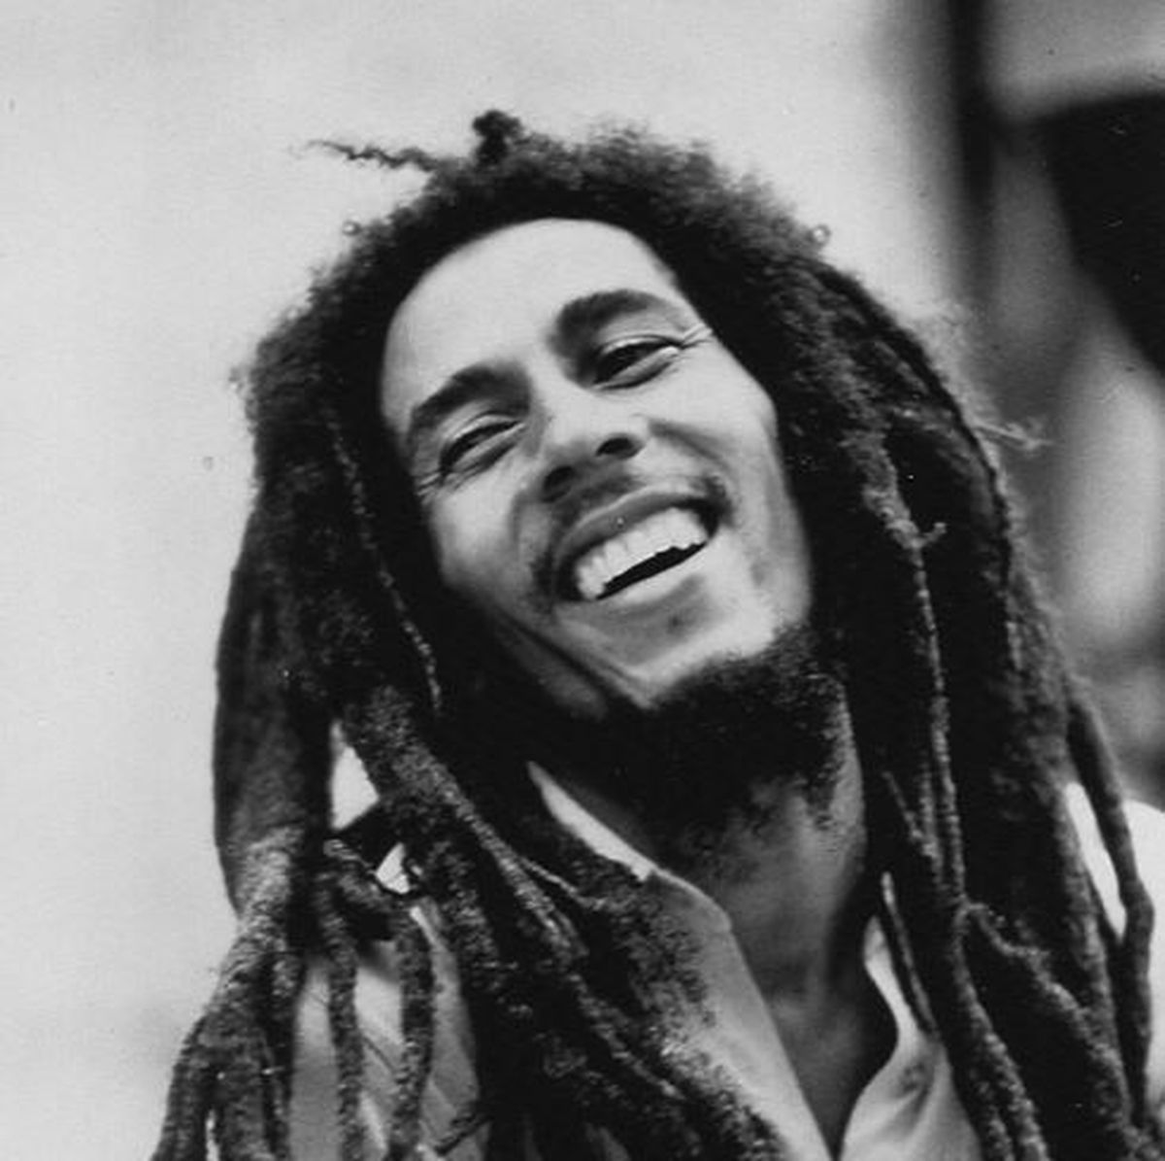
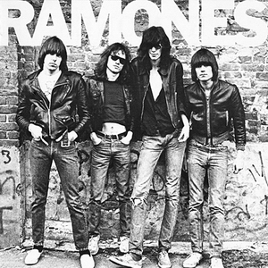
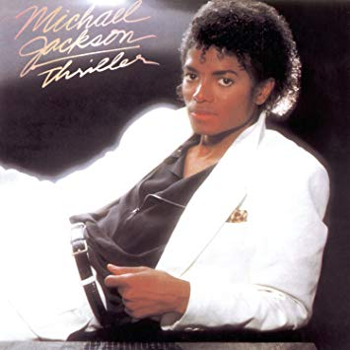
Question 2
Does duration of a song affect its position in a playlist?
Do shorter songs typically have higher track positions?
1
2
3
4
5
6

Slide 2
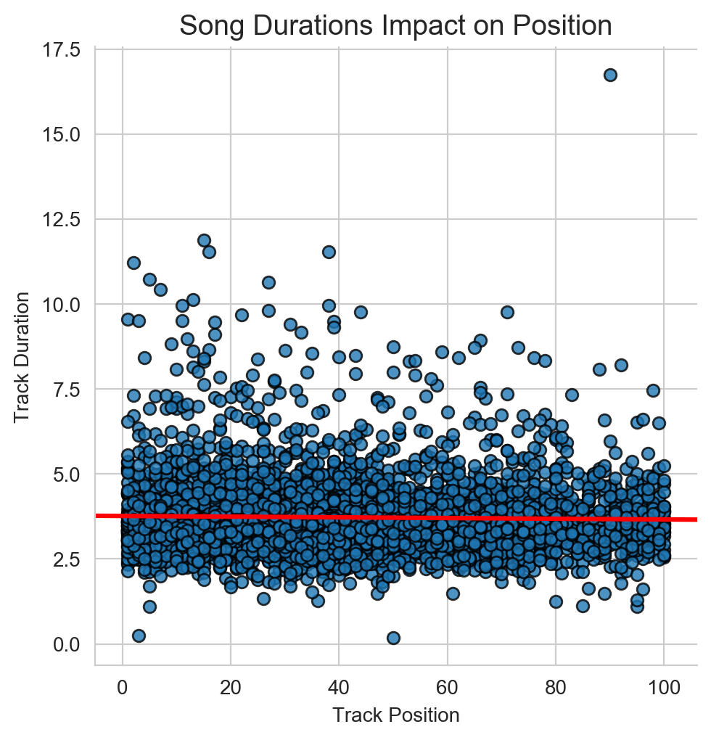

Slide 3
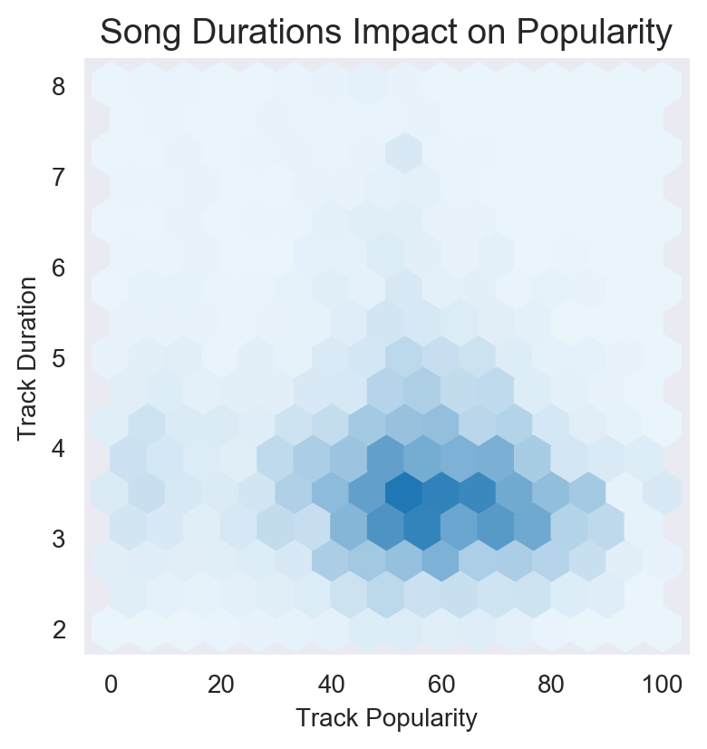

Slide 4
Question 3
How are popular songs trending in terms of their valence. Is there any correlation between the speechiness and the valence of a song?
How do songs that sound more positive (e.g. happy, cheerful, euphoric), do vs songs that sound more negative (e.g. sad, depressed, angry)?
Does speechiness trend more positively or negatively?
1
2
Speechiness: “Speechiness detects the presence of spoken words in a track”. If the speechiness of a song is above 0.66, it is probably made of spoken words, a score between 0.33 and 0.66 is a song that may contain both music and words, and a score below 0.33 means the song does not have any speech.
Valence: “A measure from 0.0 to 1.0 describing the musical positiveness conveyed by a track. Tracks with high valence sound more positive (e.g. happy, cheerful, euphoric), while tracks with low valence sound more negative (e.g. sad, depressed, angry)”.
3
4
5
6

Slide 5
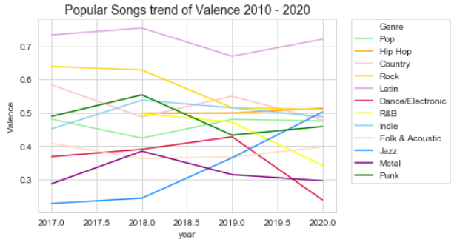
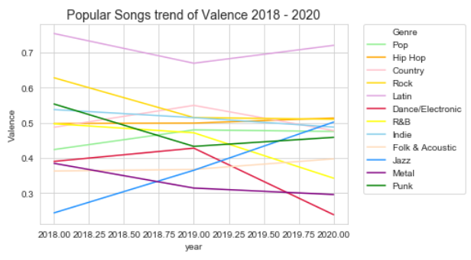
No common Valence trend for all genres.
Generally all genres have increasingly trended more negative over the past two years and at best have been flat. Jazz had the largest positive trend since 2018

Slide 6
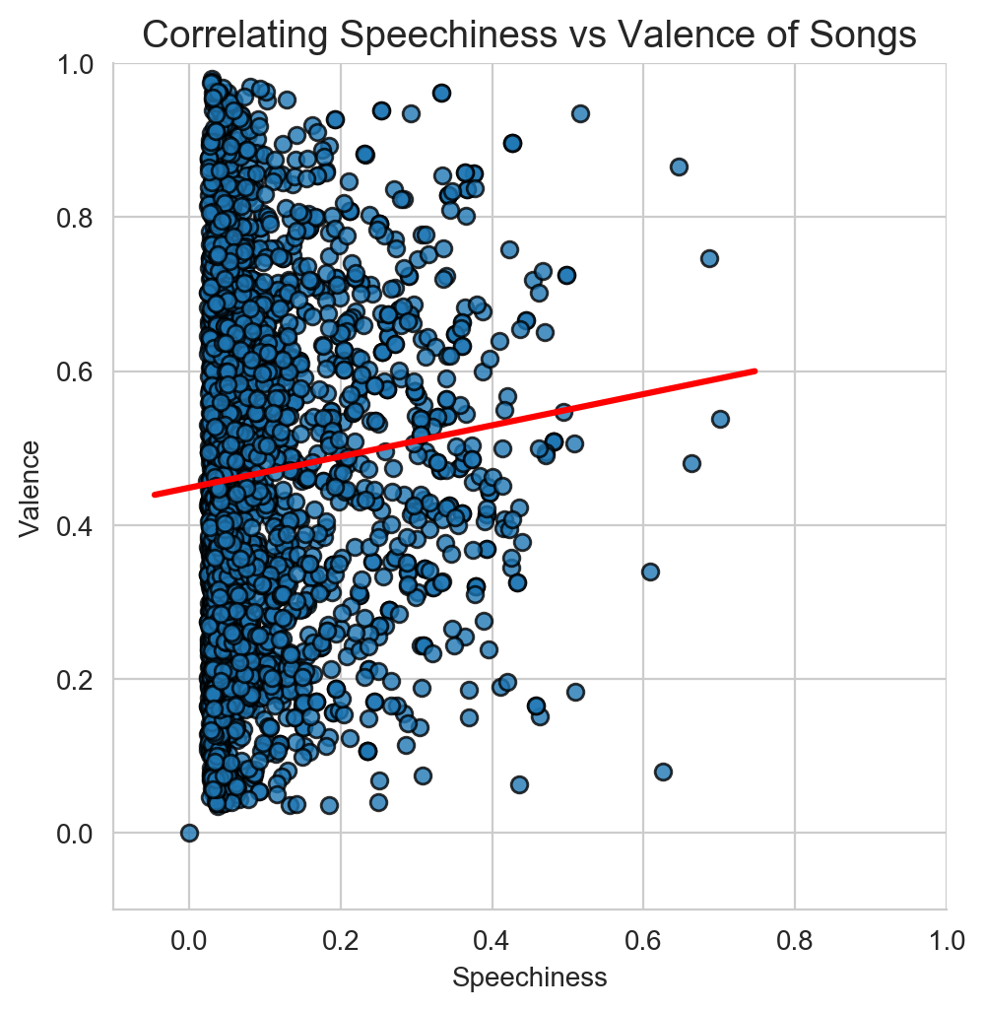
Valence Trends positively on the presence of increased words/lyrics across all genres

Slide 7
Question 4
Does the position of a song in a playlist impact it's popularity?
If a song is closer to the top of a playlist is it more popular?
Does the same trend show at the genre and playlist level?
1
2
3
4
5
6

Slide 8
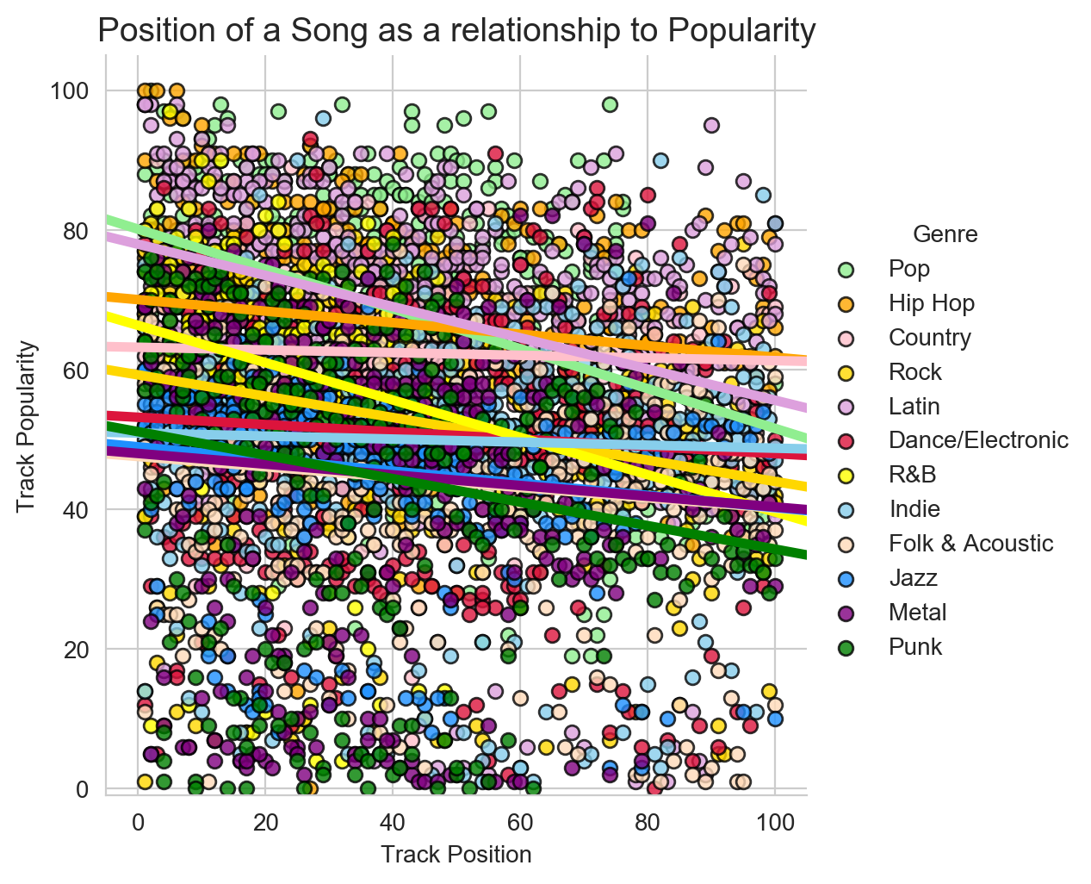
Universally all genres fit the pattern of a lower track position within a playlist aiding in increasing the popularity of the track.

Slide 9
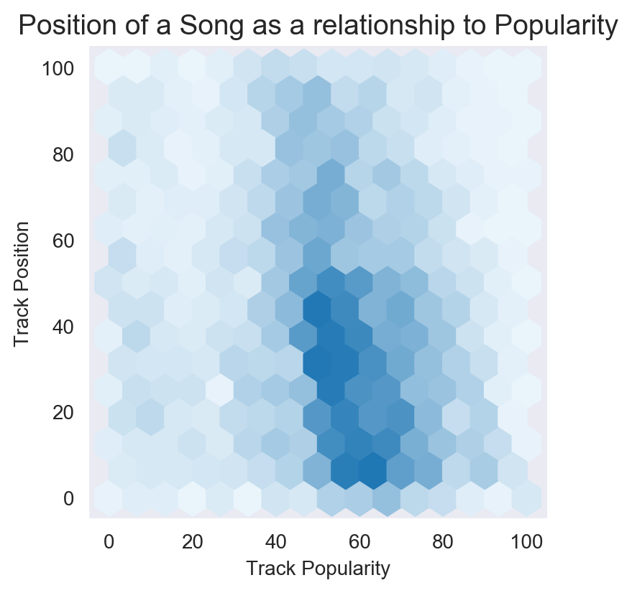
Density suggests that the better performing popularity rank holds to a track number of 40 or less.

Slide 10
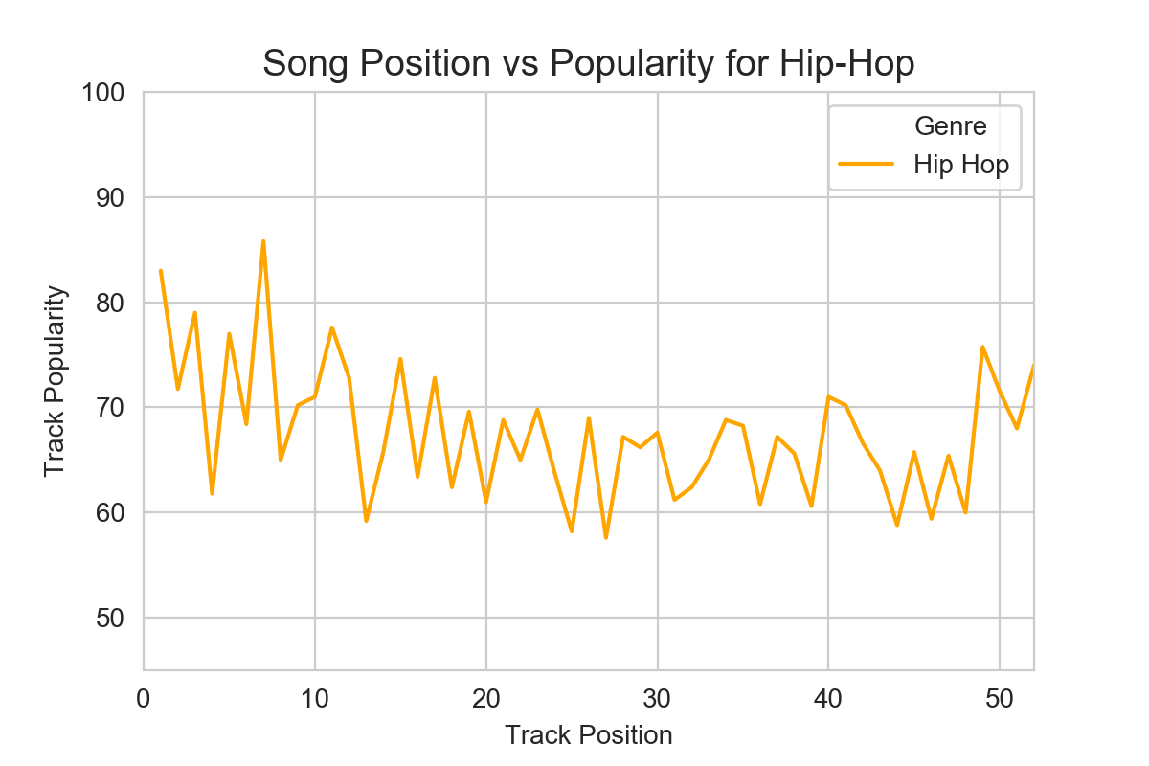

Slide 11
